Slide 1
DATABASE PROJECT
Library System
A Library Management Database built with Microsoft Access
Prepared by: Aseel Alanazi
Department of Computer Science | University of Hail

Slide 2
Project Overview
Introduction
Managing a library manually is slow and error-prone, whether registering books or tracking borrowing and return operations. This project delivers a complete digital solution built in Microsoft Access, allowing books to be registered and classified, borrower records to be managed, and every borrowing transaction to be tracked precisely from checkout to return.
4
Linked Tables
3
Data-Entry Forms
4
Queries
Library System — Database Management Project
2

Slide 3
Project Objectives
What This System Aims to Achieve
1
Organize Book Data
2
Manage Borrowers
Register every book with its author, publisher, publication year, and subject category.
Store complete borrower records: name, phone number, email, and address.
3
Track Borrowing & Returns
4
Reduce Manual Errors
Link every transaction to its due date and actual return date automatically.
Replace paper records with an accurate database that's easy to search and update.
Library System — Database Management Project
3

Slide 4
Tools & Technologies
What Powers This System
Microsoft Access 2016
The core environment used to design the entire database
Tables
Store data for books, borrowers, borrowing records, and categories
Forms
User-friendly interfaces for entering and viewing data
Queries
Retrieve and filter data as needed
Relationships
Link tables together and ensure data integrity
Library System — Database Management Project
4

Slide 5
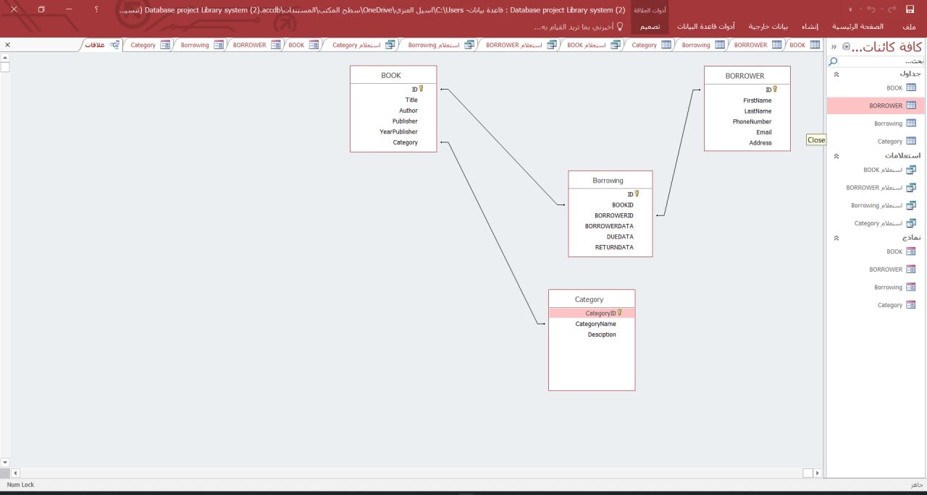
Database Design (ERD)
Tables & Relationships
The database consists of four core tables linked through One-to-Many relationships via primary and foreign keys: the Borrowing table connects to both BOOK and BORROWER, while BOOK connects to Category.
Library System — Database Management Project
5

Slide 6
Core Tables
Structure at a Glance
BOOK
BORROWER
ID • Title • Author • Publisher • YearPublisher • Category
ID • FirstName • LastName • PhoneNumber • Email • Address
Borrowing
Category
ID • BookID • BorrowerID • BorrowerDate • DueDate • ReturnDate
CategoryID • CategoryName • Description
Library System — Database Management Project
6

Slide 7
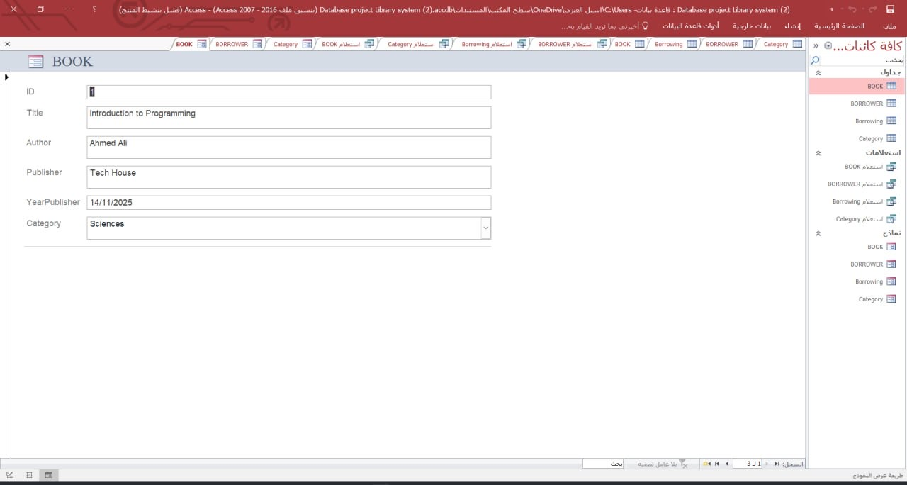
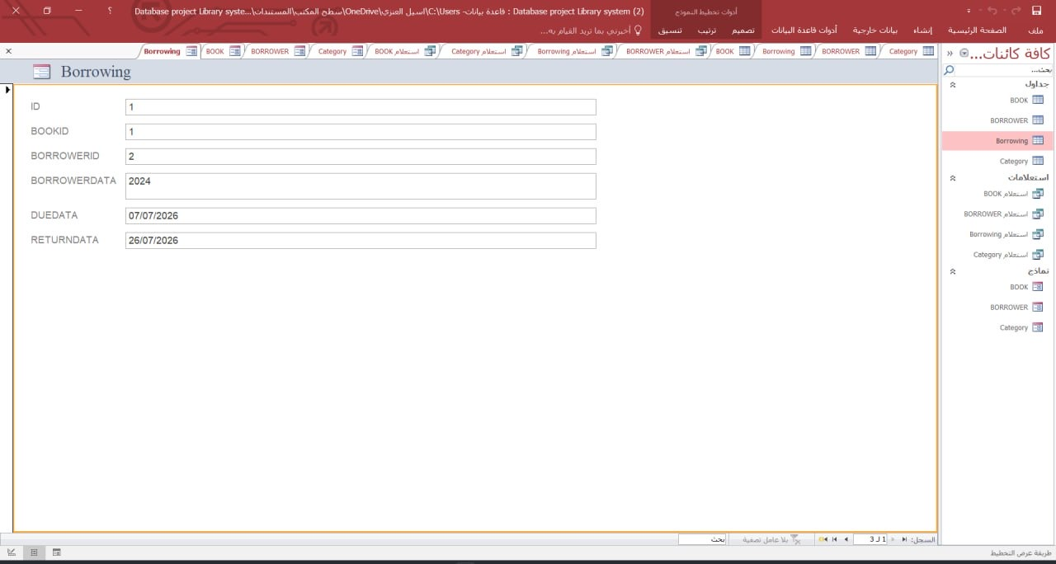
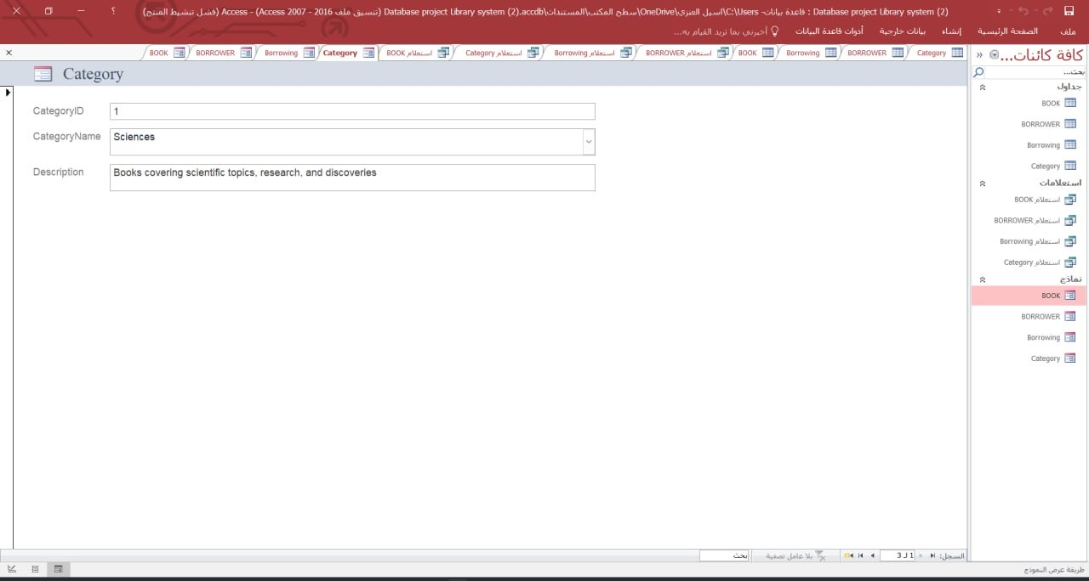
Data Entry Forms
Interfaces for Working with the Database
BOOK Form
Borrowing Form
Category Form
Library System — Database Management Project
7

Slide 8
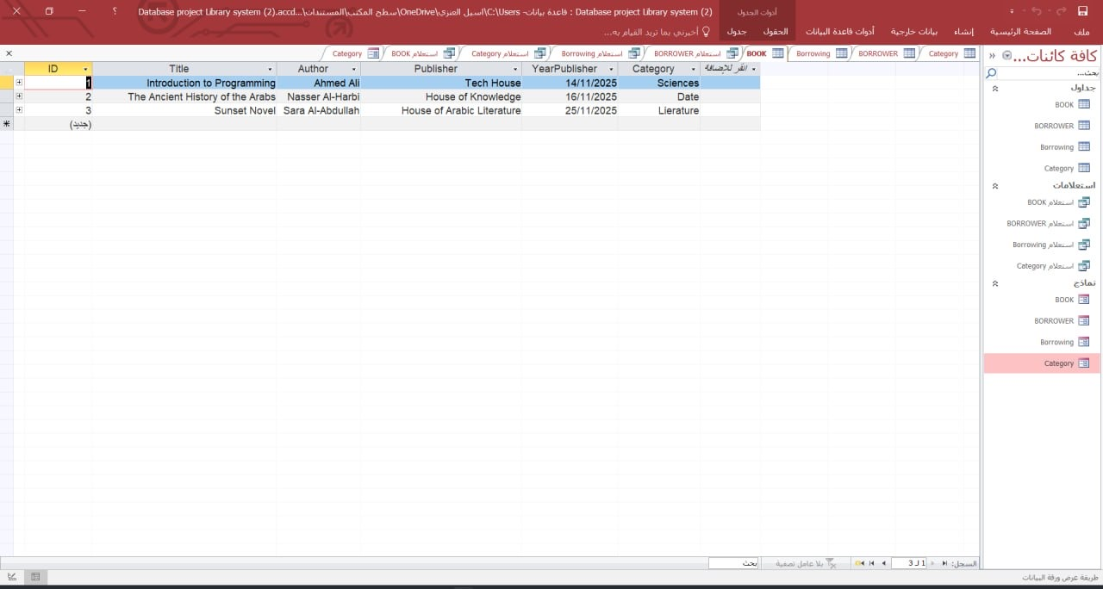
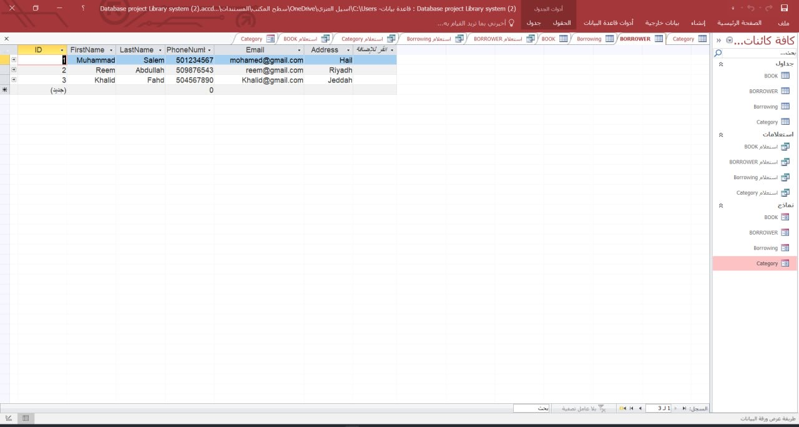
Sample Data & Queries
Real Records from the Database
BOOK Table
BORROWER Table
The sample data above shows how books and borrowers are registered. Queries are used to retrieve specific information, such as books in a given category or overdue borrowing transactions.
Library System — Database Management Project
8

Slide 9
Key Features
What Makes This System Effective
Automatic linking between books and borrowers through the Borrowing table
Precise tracking of due dates and actual return dates for every transaction
Flexible book categorization (science, history, literature...) that can grow
Easy-to-use forms for entering and editing data
Ready-made queries for fast, accurate data retrieval
Library System — Database Management Project
9

Slide 10
Thank You
Questions & Discussion
Aseel Alanazi — Department of Computer Science, University of Hail

